Slide 1


模拟电子技术基础
Analog Device
2.1 Bipolar Junction Transistor
晶体三极管
Qingfeng Zhang 张青峰
Department of Electrical and Electronic Engineering

Slide 2
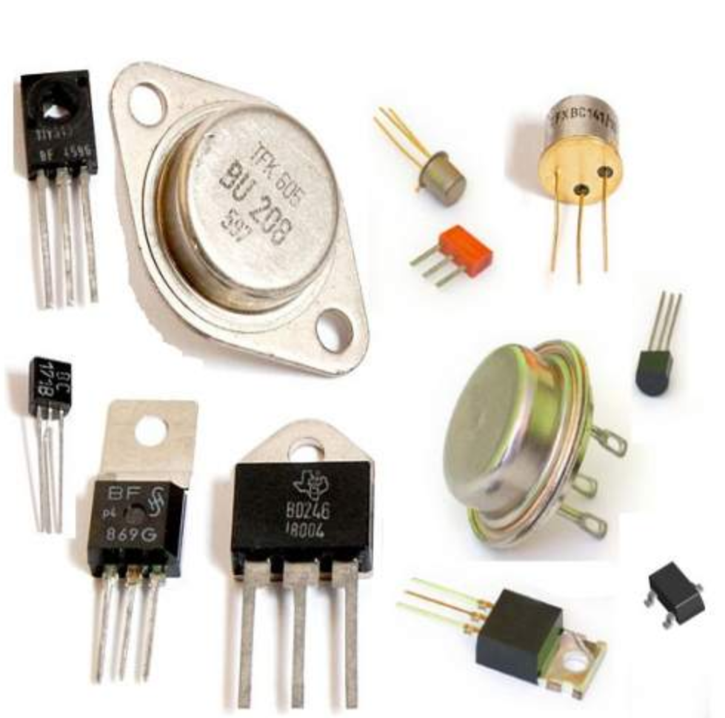
2.1 Bipolar junction transistor (BJT)
Transistor is short for “Bipolar junction transistor”
双极型晶体管，又称半导体三极管，简称为晶体管
The amplification and switching functions of transistors have promoted the leap of electronic technology

Slide 3
2.1.1 Structure of BJT
Transistor is made of two PN junctions: NPN or PNP
e
b
e
N⁺
P
N
c
N⁺
Emitter
发射极
Collector集电极
P
N
b
发射结
Base
基极
集电结
Emitter junction
BE junction
Collector junction
BC junction
c

Slide 4
NPN transistor
c
e
N⁺
P
N
c
Emitter
发射极
Collector集电极
b
b
发射结
Base
基极
集电结
e
Emitter junction
BE junction
Collector junction
BC junction
NPN

Slide 5
PNP transistor
c
e
P⁺
N
P
c
Emitter
发射极
Collector集电极
b
b
发射结
Base
基极
集电结
e
Emitter junction
BE junction
Collector junction
BC junction
PNP

Slide 6
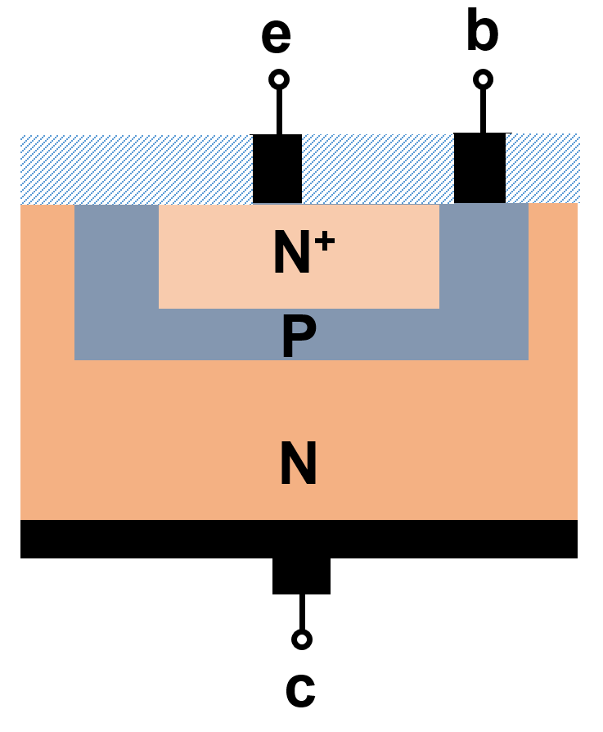
c
e
N⁺
P
N
c
b
Emitter
Collector
e
b
Base
NPN
Key features of transistor（for amplification）：
（1）Emitter region: high doping, small area
发射区掺杂浓度大，面积小。
（2）Collector region: low doping, large area
集电区掺杂浓度低，集电结面积大。
（3）Base region: low doping, very thin
基区掺杂浓度很低，且很薄。

Slide 7
2.1.2 Working principle of transistor (NPN)
Take NPN-type transistor as an example
Amplification
放大状态
Operating status of transistors
Saturation
饱和状态
Cutoff region
截止状态

Slide 8
1. Amplification mode: BE junction forward bias & BC junction reverse bias
放大模式: 发射结正向偏置，集电结反向偏置
e
c
e
c
N⁺
P
N
N⁺
P
N
b
b
R_{B}
V_{BB}
R_{E}
V_{EE}
V_{CC}
R_{C}
V_{CC}
R_{C}
Common-base amplification circuit
Common-emitter amplification circuit
共基极放大电路
共射极放大电路

Slide 9
2.1.3 Common-base amplification circuit
共基极放大电路
N⁺
P
N
I_{E}
I_{C}
I_{E}
I_{C}
e
c
e
c
U_{BE}
U_{CB}
b
b
U_{BE}
-
U_{CB}
+
I_{B}
-
+
I_{B}
R_{E}
V_{EE}
V_{CC}
R_{C}
R_{E}
V_{EE}
V_{CC}
R_{C}

Slide 10
Electric field
Forward bias of BE junction
N⁺
P
N
BE junction becomes thin or disappear.
I_{E}
I_{C}
e
c
Major carriers dominate the conduction of BE junction.
b
-
U_{BE}
+
-
U_{CB}
+
BE junction：N⁺ region is highly doped and P region is lightly doped. The electron concentration in N⁺ region is much higher than the hole concentration in P region.
I_{B}
R_{E}
V_{EE}
V_{CC}
R_{C}
Electrons (major carrier) in N⁺ region diffuse to P region under electric field.

Slide 11
Electric field
Forward bias of BE junction
N⁺
P
N
BE间的PN结宽度变薄或消失
I_{E}
I_{C}
e
c
多数载流子导电为主；
BE结：N⁺区是高掺杂，P区是低掺杂， N⁺区电子浓度远大于P区空缺浓度，以N ⁺区电子导电为主，空穴忽略不计
b
-
U_{BE}
+
-
U_{CB}
+
I_{B}
R_{E}
V_{EE}
V_{CC}
R_{C}
N⁺区的大量电子在外电场的作用下扩散到P区

Slide 12
Reverse bias of BC junction
Electric field
N⁺
P
N
BC junction becomes thicker.
I_{E}
I_{C}
Minor carriers dominate the conduction in BC junction.
e
c
BC junction: N and P regions are both lightly doped, the electron and hole concentration is very low, much smaller than the electron concentration drifted from N⁺ region.
b
-
U_{BE}
+
-
U_{CB}
+
I_{B}
R_{E}
V_{EE}
V_{CC}
R_{C}
Most electrons drifted from N⁺ region are accelerated by the electric field of BC junction and collected by the collector. Only small portion is collected by base.

Slide 13
Reverse bias of BC junction
PN结内电场+外电场
BC间的PN结宽度变厚
N⁺
P
N
I_{E}
I_{C}
少数载流子导电为主；
e
c
BC结：N区和P区都是低掺杂， 电子和空穴浓度都很低，远小于从N⁺区漂移过来的电子浓度
b
-
U_{BE}
+
-
U_{CB}
+
I_{B}
从N⁺区漂移过来的电子在BC间的内点场和外电场作用下，大部分漂移到N区形成电流I_{C}，少部分被基极收集形成电流I_{B}。还有少部分电子与P区的空穴复合，但是可以忽略不计
R_{E}
V_{EE}
V_{CC}
R_{C}

Slide 14
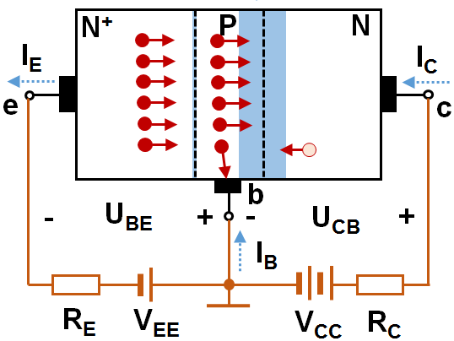
1. 放大机理
作用过程：

Slide 15
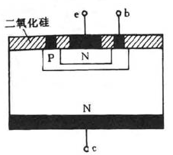
2. 影响放大的因素
动态由静态决定！
影响静态放大系数因素：
集电极和和基极面积比例；
发射区和基区的掺杂浓度比；

Slide 16

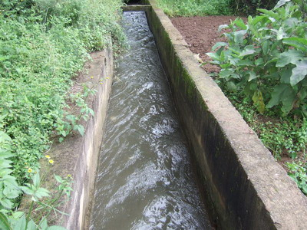
3. 放大的关键
U_{BE}的开关控制作用；
控制能够实现交直流转换；
小能量控制大能量的结构；
举例：水流的控制
思考：放大的交流能量从何而来？
放大器→控制转换器

Slide 17
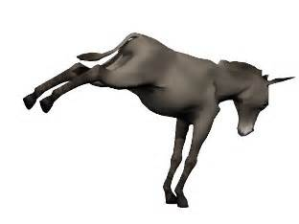
How does an amplifier work?
William Shockley, Nobel-Prize winning co-inventor of the transistor (a revolutionary electronic amplifier dating from the 1940s) had a vivid way of explaining it:
“If you take a bale of hay (干草) and tie it to the tail of a mule (骡子) and then strike a match (火柴) and set the bale of hay on fire, and if you then compare the energy expended shortly thereafter by the mule with the energy expended by yourself in the striking of the match, you will understand the concept of amplification."

Slide 18
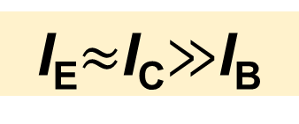
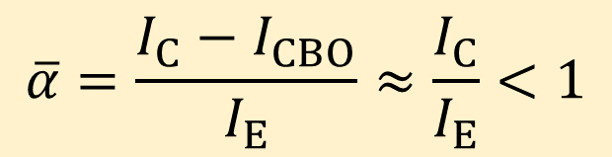
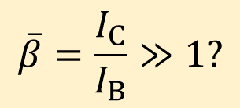
I_{E}=I_{C}+I_{B}
Electric field
N⁺
P
N
I_{E}
I_{C}
e
I_{CBO}
c
Common-b DC amplification factor
b
共基极直流放大系数
-
U_{BE}
+
-
U_{CB}
+
I_{B}
R_{E}
V_{EE}
V_{CC}
R_{C}
Q: Why common-b amplification coefficient is not defined as:
I_{CBO}：the reverse saturation current when emitter is open.

Slide 19
2.1.4 Common-emitter amplification circuit
共射极放大电路
I_{E}
I_{C}
I_{E}
I_{C}
e
N⁺
P
N
c
I_{B}
b
I_{B}
R_{B}
V_{BB}
R_{B}
V_{BB}
V_{CC}
R_{C}
V_{CC}
R_{C}
V_{CC}> V_{BB}

Slide 20
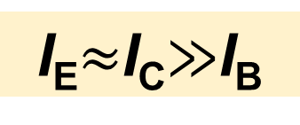
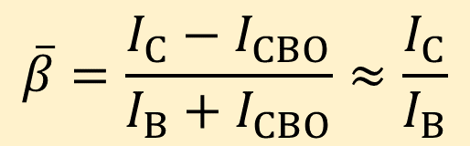
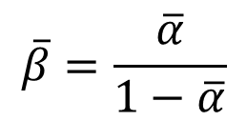
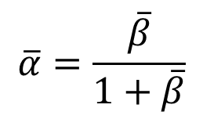
Electric field
I_{E}=I_{C}+I_{B}
N⁺
P
N
I_{E}
I_{C}
e
I_{CBO}
Common-e DC amplification factor
c
b
共射极直流放大系数
I_{B}
R_{B}
V_{BB}
V_{CC}
R_{C}

Slide 21
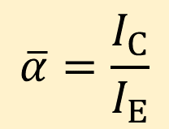
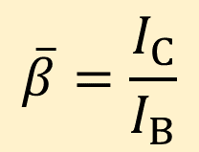


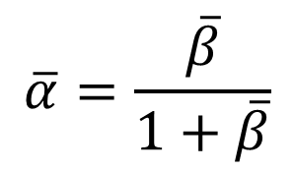
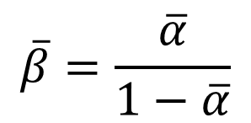
Common-b amplification coefficient
Common-e amplification coefficient

Slide 22
P
N
Question!
N⁺
I_{E}
I_{C}
e
c
Why N⁺ region should be highly doped?
b
I_{B}
Why P region should be thin?
R_{B}
V_{BB}
V_{CC}
R_{C}
Why P region should be lightly loped?

Slide 23
Assume P-region is very thick
Internal and external electric field
N⁺
P
N
I_{E}
I_{C}
e
c
b
I_{B}
R_{B}
V_{BB}
V_{CC}
R_{C}

Slide 24
P-region is lightly doped
N⁺
P
N
P-region is highly doped
I_{E}
I_{C}
e
c
N⁺
P⁺
N
I_{E}
I_{C}
b
e
c
I_{B}
R_{B}
V_{BB}
b
I_{B}
V_{CC}
R_{C}
R_{B}
V_{BB}
V_{CC}
R_{C}

Slide 25
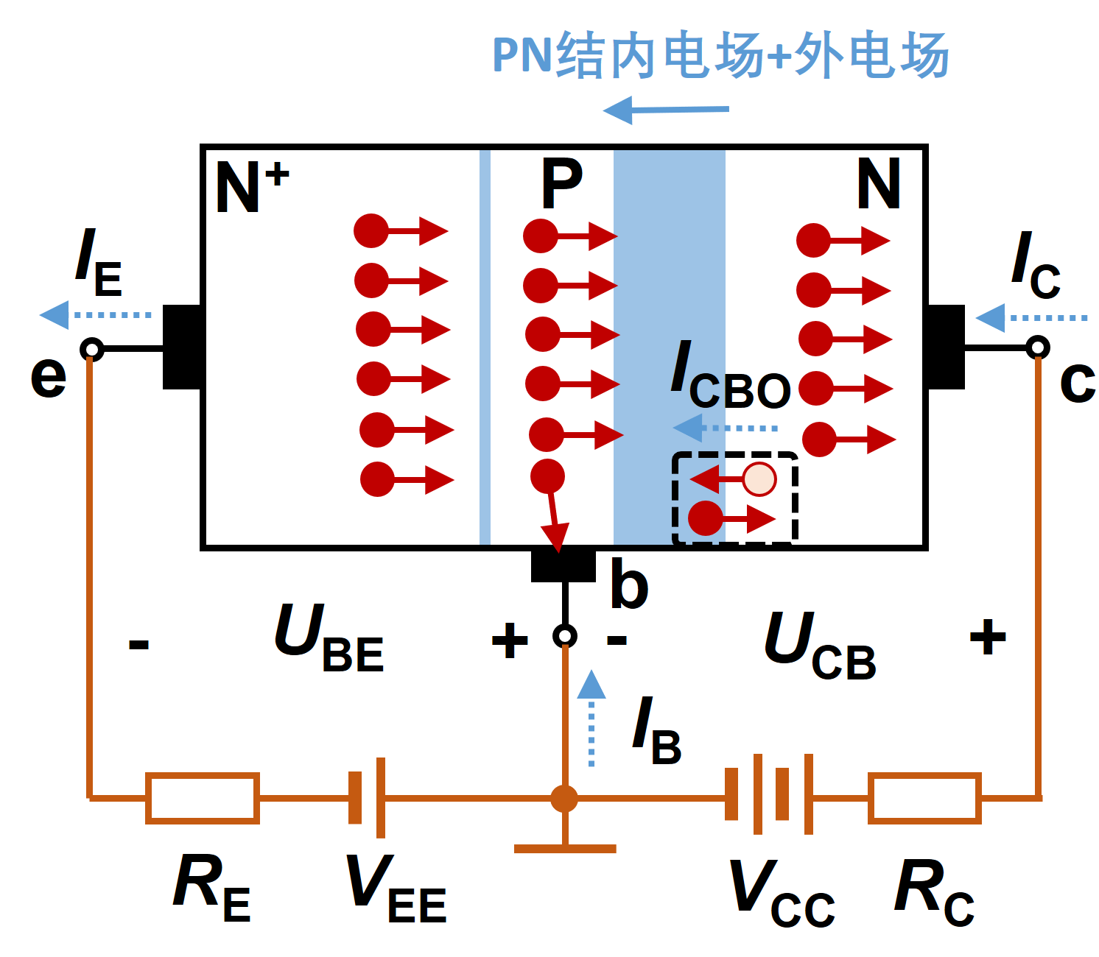
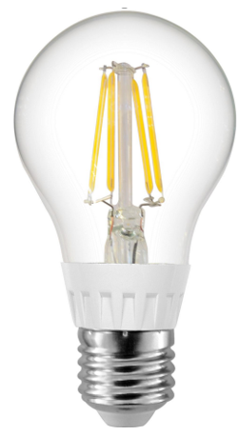
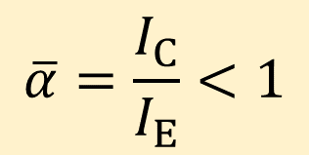
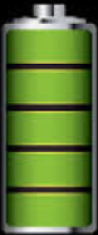
Common-base amplifier
I_{E}
I_{C}
I_{B}

Slide 26
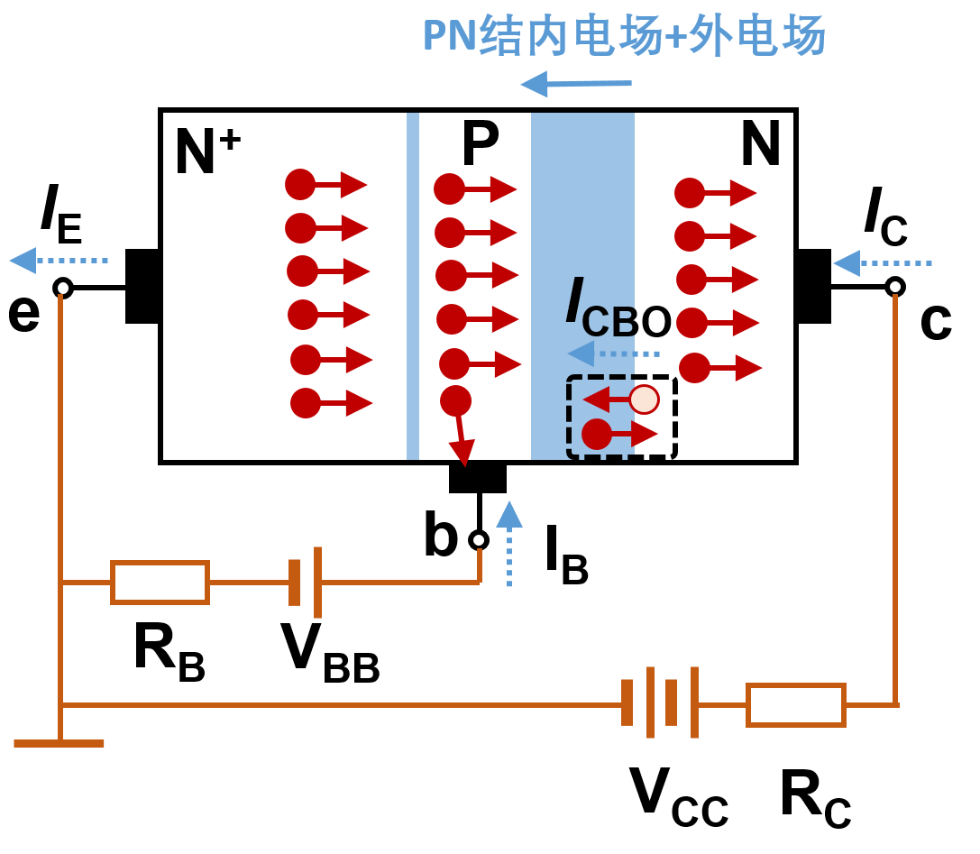

Common-emitter amplifier
I_{E}
I_{C}
I_{B}

Slide 27


Common-emitter AC amplification circuit
Direct current
直流电流
i_{c}
I_{C}
c
i_{b}
I_{B}
R_{C}
i_{B} = I_{B} + i_{b}
b
e
R_{B}
u_{O}
R_{B}
+
I_{E}
V_{CC}
Alternating current
交流瞬时电流
u_{i}
i_{e}
-
Total current
总瞬时电流
V_{BB}
交流复数值
交流有效值

Slide 28



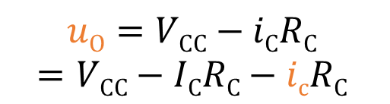


Common-emitter AC amplification circuit
i_{c}
I_{C}
c
i_{b}
I_{B}
R_{C}
b
e
R_{B}
u_{O}
R_{B}
I_{E}
Output voltage (DC+AC):
+
V_{CC}
u_{i}
i_{e}
-
V_{BB}
Output DC voltage:
Output AC voltage:

Slide 29
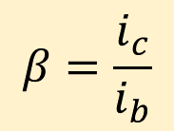
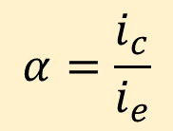
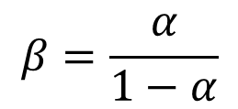
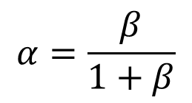


Common-emitter AC amplification coefficient
共射交流放大系数
Common-e:
i_{c}
I_{C}
c
Common-b:
i_{b}
I_{B}
R_{C}
b
e
R_{B}
u_{O}
R_{B}
+
I_{E}
V_{CC}
u_{i}
i_{e}
-
V_{BB}
In general case:

Slide 30
2．发射结正向偏置、集电结正向偏置—饱和状态
饱和状态的特点
（1）U_{CB} (=U_{CE}-U_{BE})≤0。集电结零偏或正偏
（2）I_{C} ≠ βI_{B}，I_{B}失去了对I_{C}的控制。
（3) 集电极饱和电压降U_{CES}较小
小功率硅管0.3∼0.5V。

Slide 31
（4）饱和时集电极电流
（5） U_{CE}对I_{C}的影响大，
当U_{CE}增大，I_{C}将随之增加。
当UCE增大使集电结从正偏往零偏变化过程中， UCE越大，到达集电区的非平衡少子就越多，Ic将随着UCE增大而增加。

Slide 32
3．发射结反向偏置、集电结反向偏置—截止状态
截止状态的特点：
（1） U_{BE}小于死区电压。
（2） I_{C}=I_{CBO}，I_{B}=－I_{CBO}

Slide 33


2.1.4 The input and output I-V characteristics
Common-emitter
Input I-V characteristics:
i_{C}
N
+
c
i_{B}
b
u_{CE}
i_{B}
+
P
e
u_{CE}=0
u_{BE}
N⁺
i_{E}
-
-
1) When u_{CE}=0, BE and BC junction are forward biased by u_{BE}. The internal electric field is in BC junction is decreased, most electrons are collected by the Base. The I-V curve is similar to that of PN junction.
u_{BE}

Slide 34
Common-emitter
i_{B}
u_{CE}=0
0.5V
>1V
i_{C}
N
+
c
i_{B}
b
u_{CE}
+
P
e
u_{BE}
N⁺
i_{E}
-
-
u_{BE}
2) When u_{CE} increase (<1V), the electric field in BC junction increase. Some electrons are collected by Collector, and the left are collected by Base. To reach the same value of i_{B}, u_{BE} should be larger. Hence the I-V curve shifts to right.
3) When u_{CE} is large enough (>1V), the electric field in BC junction is strong enough, and most electrons are collected by Collector and Collector is saturated. Even further increase u_{CE}, the curve does not shift any more.

Slide 35




Common-emitter
Output I-V characteristic
i_{C}
N
+
c
i_{B}
b
u_{CE}
i_{C}
i_{B}=80μA
+
P
e
u_{BE}
N⁺
i_{E}
-
60μA
-
Saturation
40μA
1) Cut-off region：
Amplification
u_{BE} < U_{ON} threshold voltage
20μA
u_{CE} > u_{BE}
0μA
u_{CE}
Cut-off 截止区

Slide 36

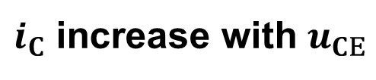
i_{C}
i_{B}=80μA
Common-emitter
i_{C}
60μA
N
+
c
Saturation
i_{B}
u_{CE}
40μA
+
P
b
e
u_{BE}
N⁺
Amplification
i_{E}
20μA
-
-
0μA
Cut-off
u_{CE}
2) Amplification region放大区：
u_{BE} > U_{ON}
3) Saturation region饱和区：
u_{CE} > u_{BE}
u_{BE}> U_{ON}
BC junction is reverse biased
u_{CE}< u_{BE}
BC junction is forward biased

Slide 37
NPN
PNP
Question!
i_{C}
i_{C}
N
+
P
-
c
c
i_{B}
i_{B}
u_{CE}
-
b
u_{CE}
+
P
b
e
N
e
u_{BE}
u_{BE}
P⁺
i_{E}
N⁺
i_{E}
-
+
+
-
Amplification mode
Amplification mode

Slide 38
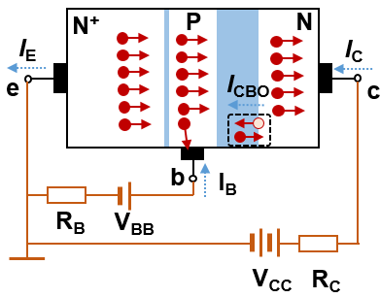
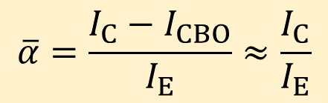
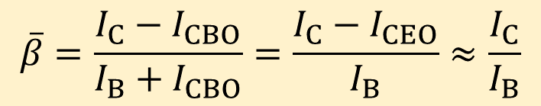

2.1.5 Summary of key parameters of transistor
1) Common-b DC amplification factor:
2) Common-e DC amplification factor:
3) I_{CBO}: when emitter is open, the reverse saturation current in BC junction
4) I_{CEO}: when base is open, the reverse saturation current Between emitter and collector

Slide 39
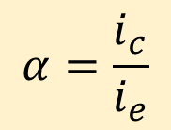
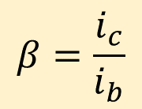


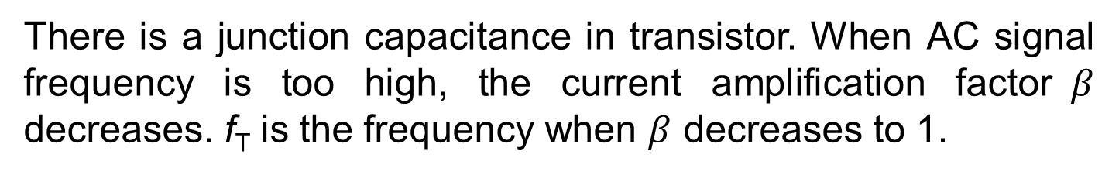
5) Common-b AC amplification factor:
6) Common-e AC amplification factor:
7) Cut-off frequency f_{T} (will talk about his in the 4th chapters)

Slide 40
Limit parameters 极限参数
1) The reverse breakdown voltage of BE junction U_{(BR)EBO}
2) The reverse breakdown voltage of BC junction U_{(BR)CBO}
3) The reverse breakdown voltage of CE junction U_{(BR)CEO}
4) Maximum current allowed in collector: I_{CM}

Slide 41
5) The maximum power dissipation allowed in collector: P_{CM}
P_{CM} determined the temperature of transistors. For Si transistor, T<150º. For Ge transistor, T<70º.
i_{C}
I_{CM}
P_{CM}=u_{CE}xi_{C}
Safe operation area
U_{(BR)CEO}
u_{CE}

Slide 42
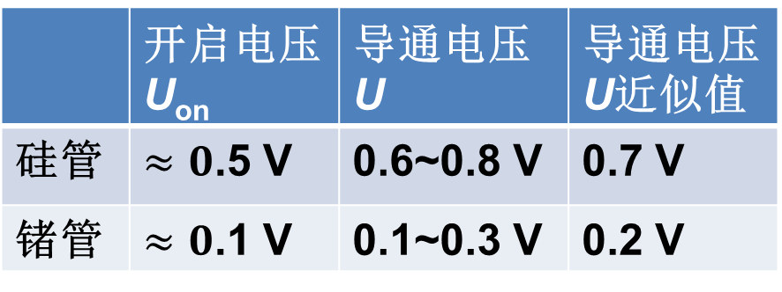
Homework1-2:
1.8, 1.9, 1.10, 1.12
Diode | Threshold voltage U_{ON} | Working voltage U
Si |  | 0.6~0.8 V | 0.7 V
Ge |  | 0.1~0.3 V | 0.2 V

